Slide 1
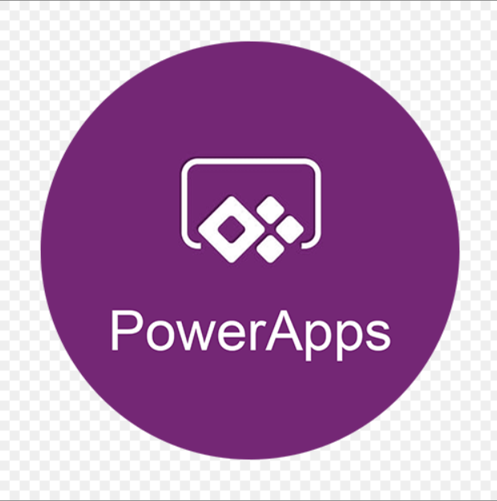
POWER APPS Training

Slide 2
Power Platform Admin Center
The Power Platform admin center provides a unified portal for administrators to manage environments and settings for Power Apps, Power Automate, and customer engagement apps (Dynamics 365 Sales, Dynamics 365 Customer Service, Dynamics 365 Field Service, Dynamics 365 Marketing, and Dynamics 365 Project Service Automation)

Slide 3
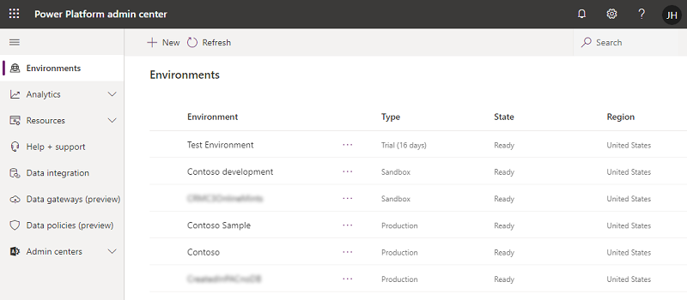
ADMIN CeNTER

Slide 4
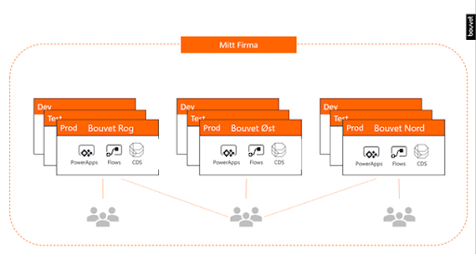
Platform environment

Slide 5
Demo : creating environment and add users

Slide 6
TranslAting 2010 workflows to power automate

Slide 7
Submit a template to the Power Automate gallery
https://docs.microsoft.com/en-us/power-automate/publish-a-template

Slide 8
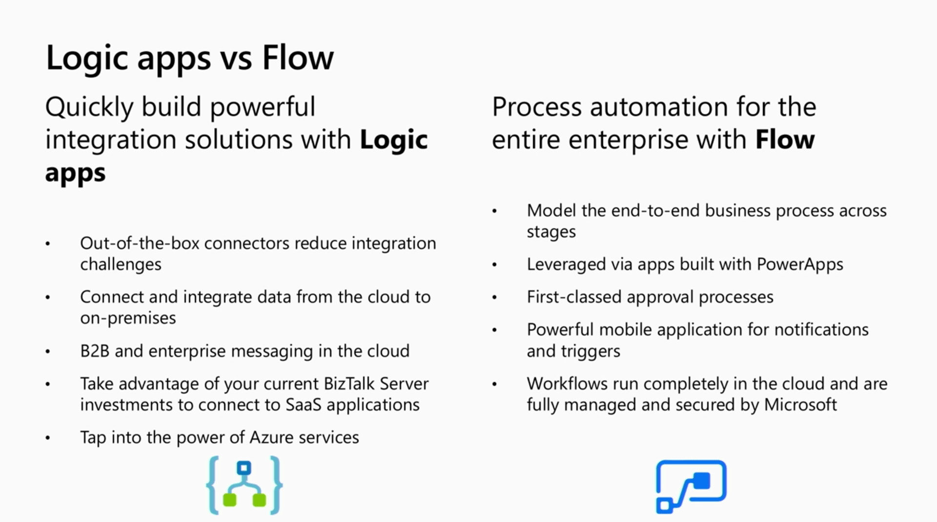
Power automate vs logic apps

Slide 9
POWER APPS Introduction
Power Apps is used to build apps that allow you to take action on your data.
Power Apps is great for replacing paper forms, legacy solutions, or just that spreadsheet that you and a few coworkers pass around.
Using the skills and knowledge you already possess; you can build apps to interact with existing data by using more than 275 connectors.
Once built on the web native Power Apps platform, these apps live in the cloud and can be easily shared and run on a variety of platforms including PCs, laptops, tablets, and mobile phones.

Slide 10
What is Power Apps ?
Microsoft PowerApps is a popular choice for developers to build low code apps.
PowerApps is a service for creating business apps across platforms quickly and easily.
PowerApps takes that all away by enabling power users and developers to quickly create apps in hours instead of months.

Slide 11
Licensing and Pricing Condition
Please find the below url for Licensing....
Understanding Power Platform Licensing | Microsoft Docs
Please find the below url for Pricing....
Pricing - Power Apps (microsoft.com)

Slide 12
To CREATE THE POWER APPS
https://make.powerapps.com/

Slide 13
To Create Site
Please refer the below url to create a new site....
Create a site - SharePoint in Microsoft 365 | Microsoft Docs
Please find the upcoming slides, how to create the site.....

Slide 14
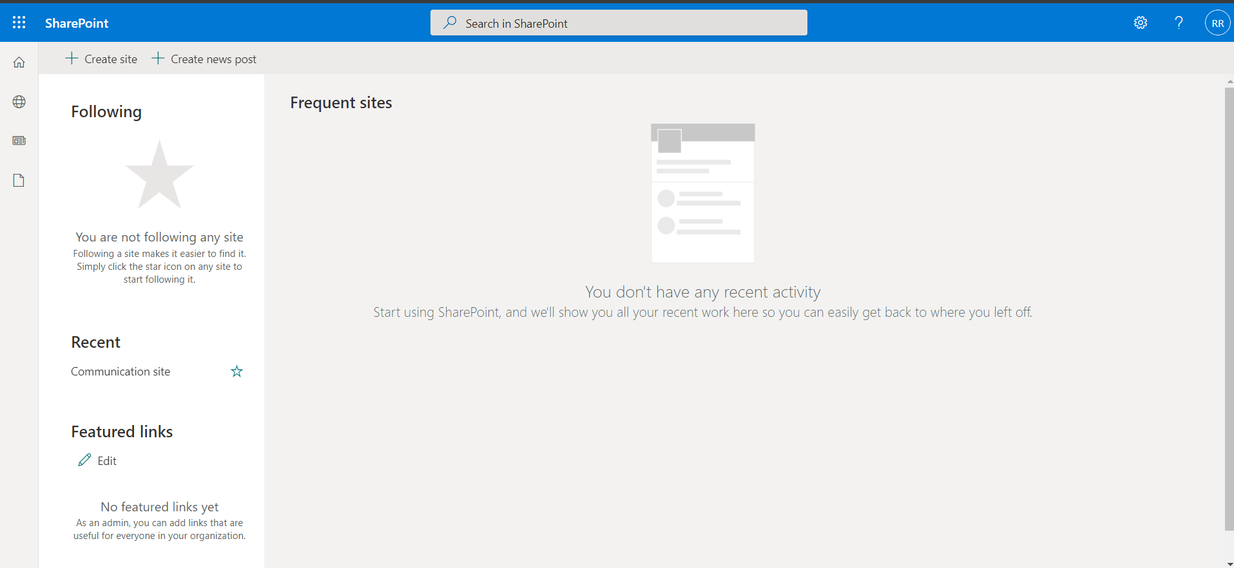

Slide 15
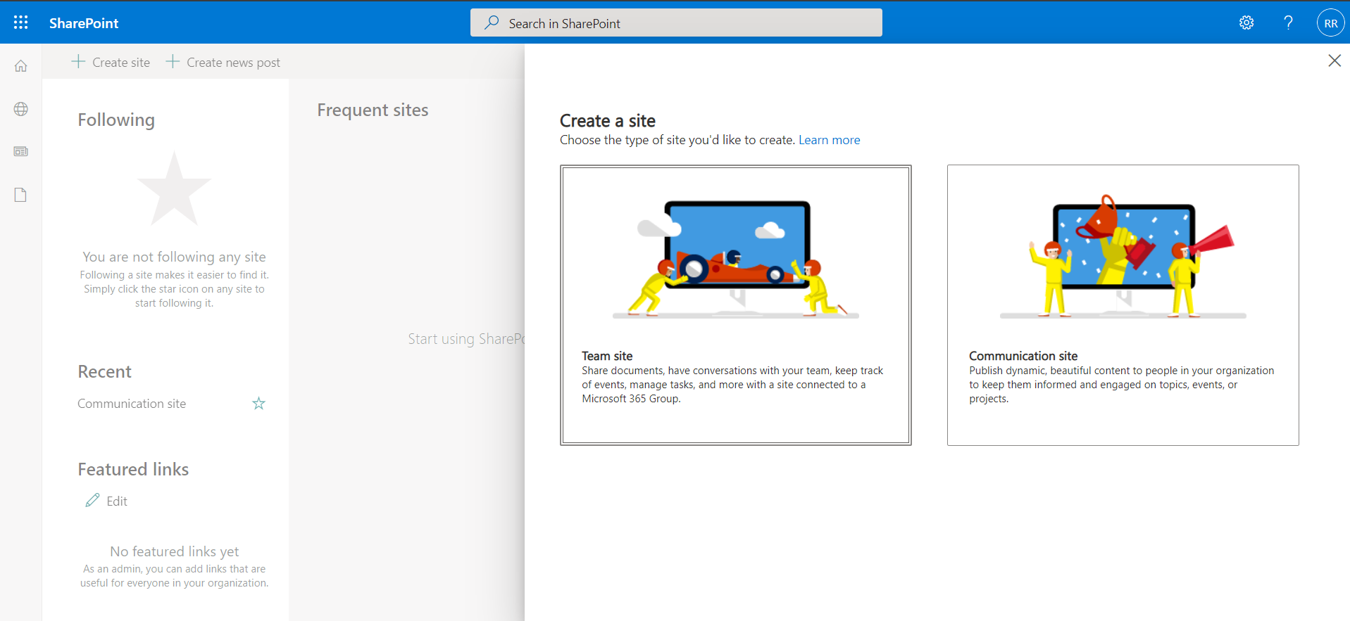

Slide 16
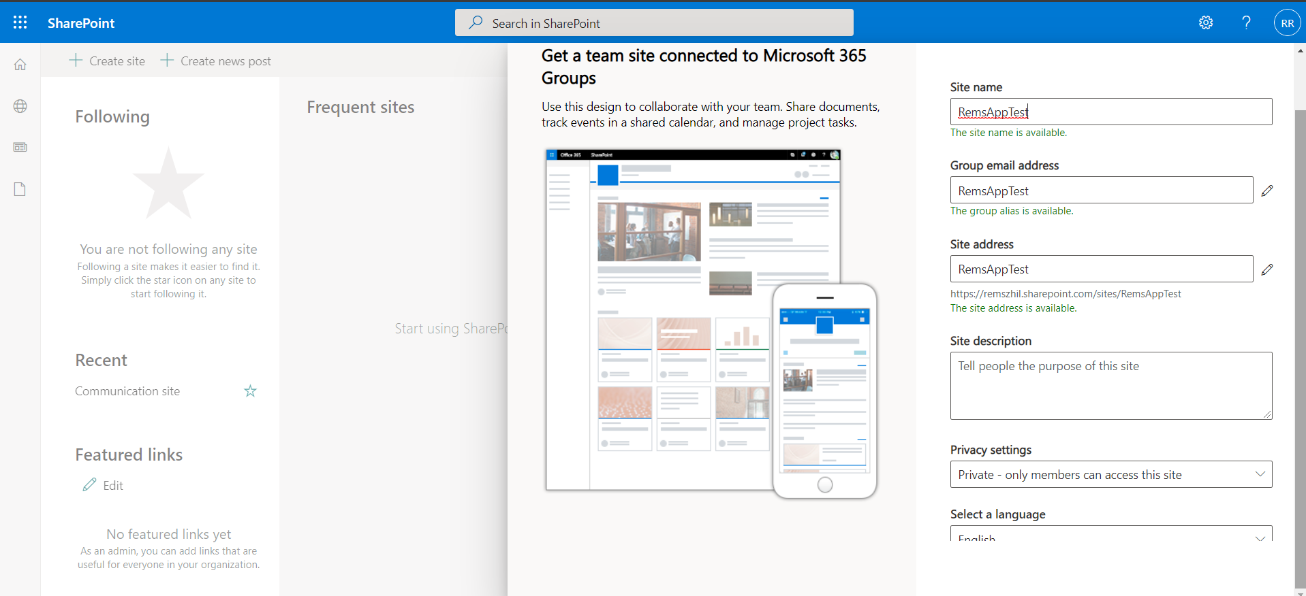

Slide 17
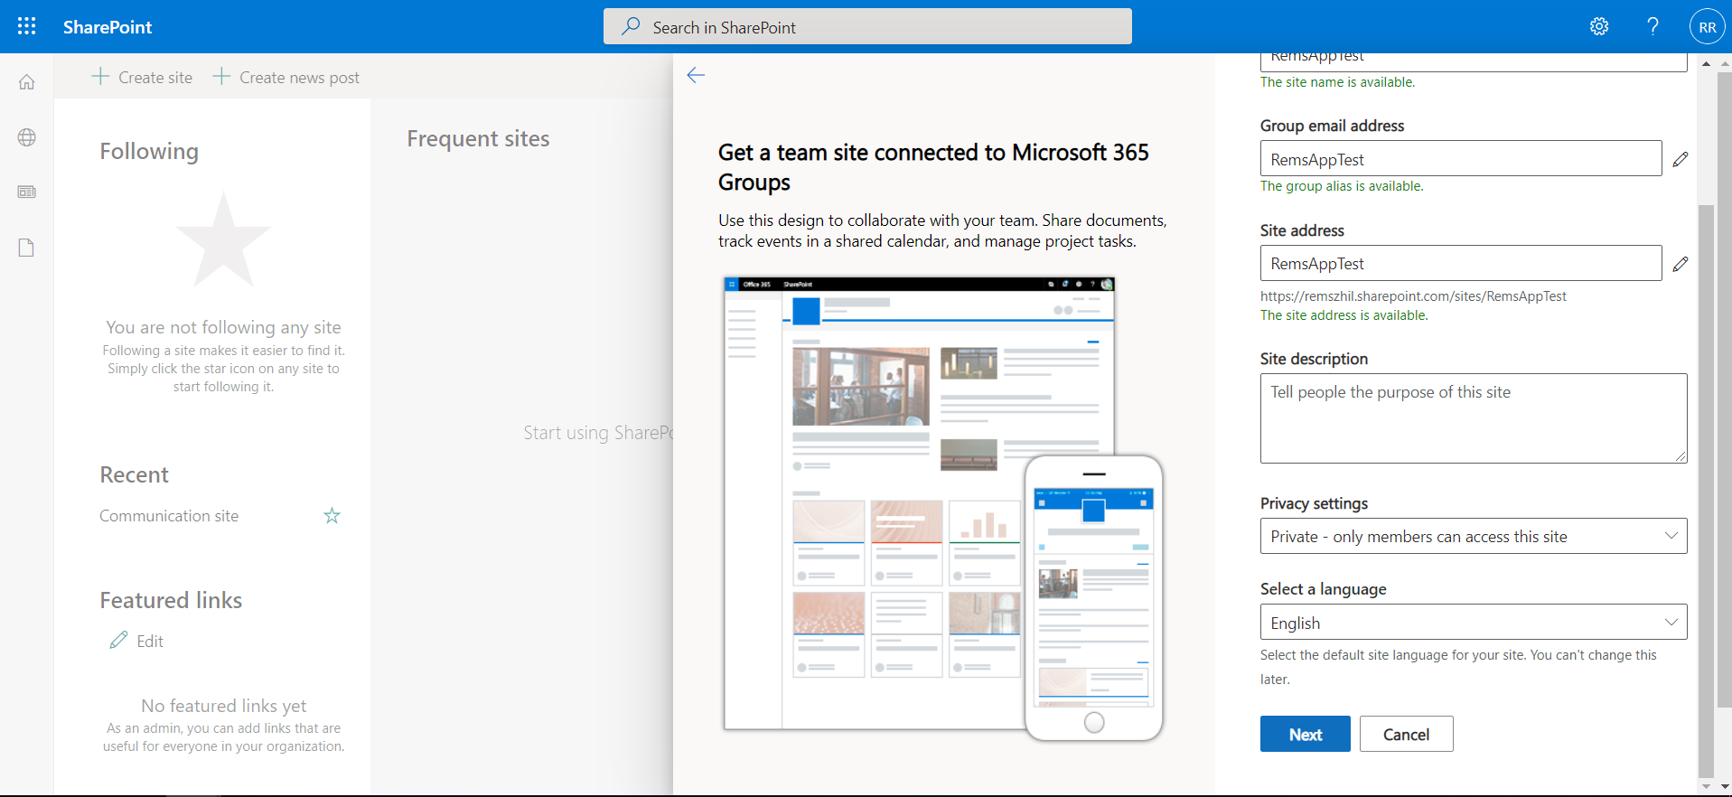

Slide 18
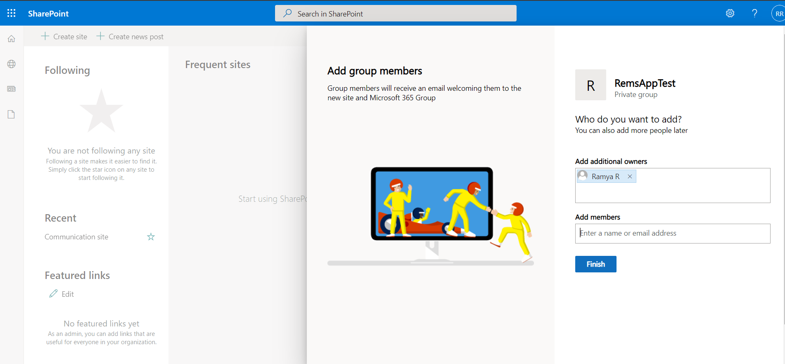

Slide 19
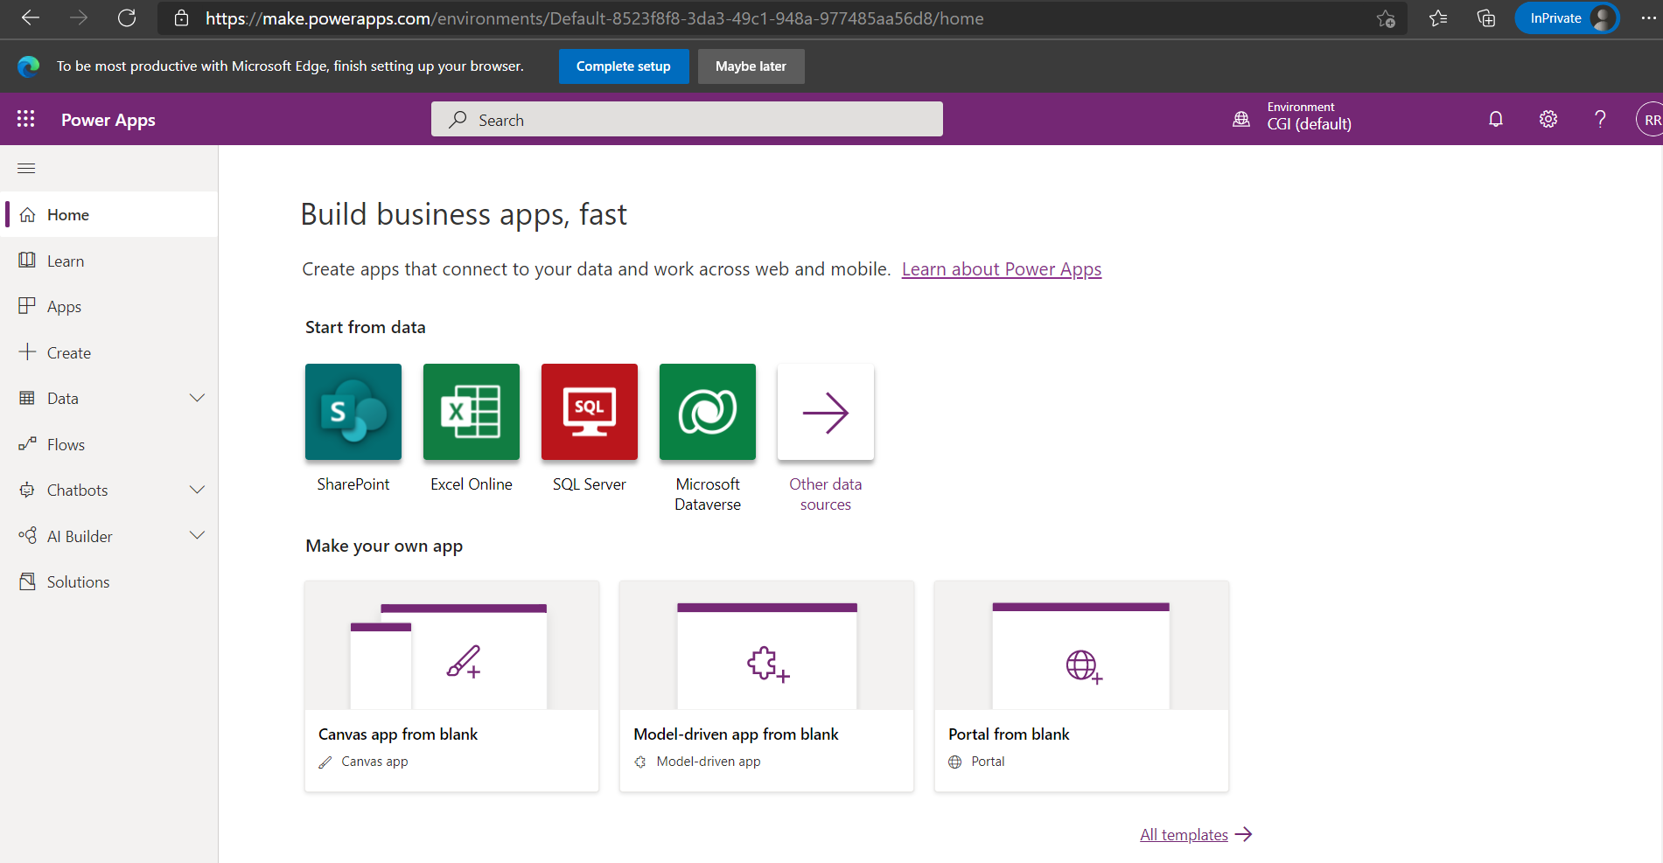
POWER APPS PAGE LOOKS LIKE......

Slide 20
Types of Apps
There are 3 types of Apps. They are,
Canvas App
Model - Driven App
Portal

Slide 21
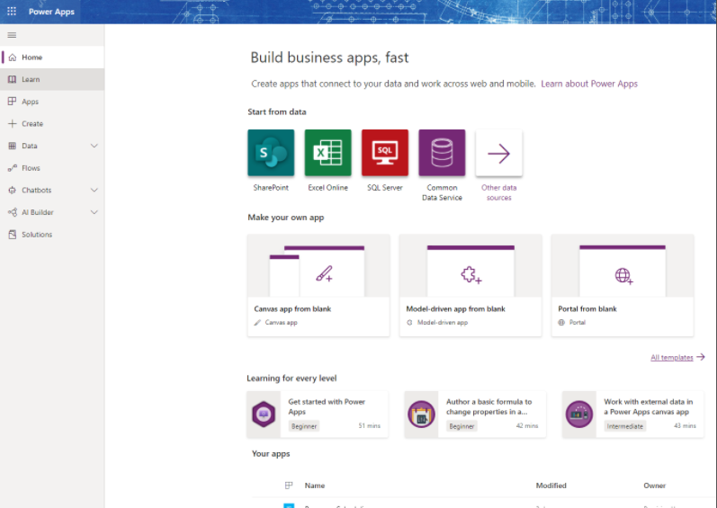
Types of Apps Images

Slide 22
Canvas Apps
Canvas apps are a great option when you want to build an app from a blank canvas. You start by choosing the screen size: tablet or mobile, then you have a blank screen from which to build.
You can interact with data in your app by adding data sources.
Drag and drop various controls and add the desired functionality by writing Excel style formulas. Canvas apps provide you complete flexibility when building your apps.
Below are a couple of examples of a mobile canvas app built by Heathrow Airport.

Slide 23
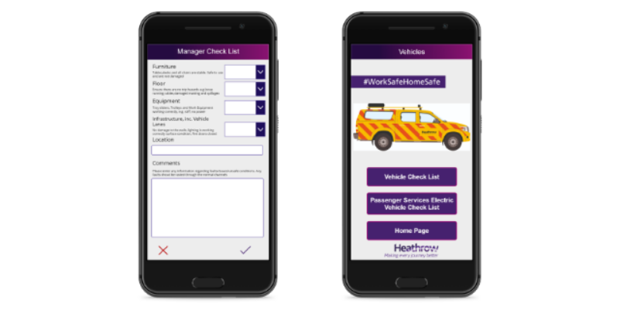
Example of Canvas App

Slide 24
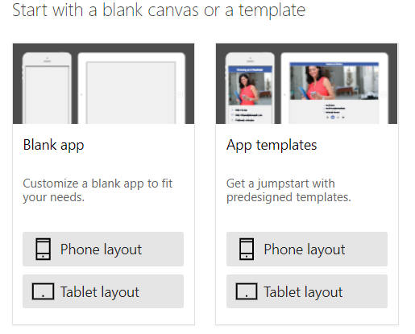
To START WITH CANVAS APP

Slide 25
Demo On CANVAS APPS
Live Demo

Slide 26
Model-Driven Apps
Model-driven apps build from data in Microsoft Dataverse. Power Apps will build you a great looking, fully functional app to act upon and interact with this data.
With model-driven apps, there is no need to worry about choosing the app size; it is responsive, meaning it works on mobile or tablet with no extra work by you. You define the relationships, forms, views, business rules, and more at the data layer, inside of the Dataverse, giving you enough control to get your business result without writing all of the formulas yourself.
Below is an example of a fundraiser donations tracking model-driven app.

Slide 27
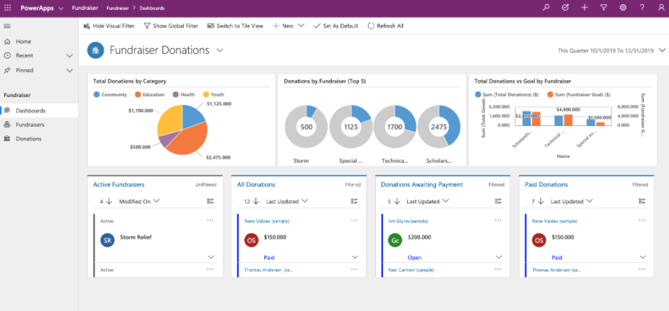
Example of Model – Driven App

Slide 28
Portals
Portals bring the power of no-code solutions to building externally facing websites.
Through the Power Apps interface, you can build an anonymous or authenticated website that allows users to interact with data held in Dataverse.
The same drag and drop experience you enjoy when building apps is available to build these rich, interactive websites.

Slide 29
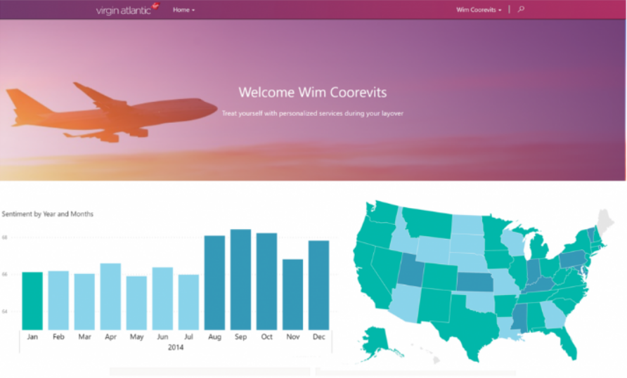
Example of Portal

Slide 30
Power Apps Components
These are the main components for your Power App:
Screens
Data Sources
Forms
Controls
Variables
Collections

Slide 31
Explanations
Screens is a page in your app. You can have multiple pages in your app.
Data Sources – Creating connections to your data and flow. (Flow will allow you to complete secondary actions based on the data in your app)
Forms – New/Edit/Display Forms for your content. Adding a form makes it simpler to submit data to your data source.
Controls – The basic controls are fields to hold or input your data. Example: text field, dropdown menu, radio buttons etc. More complex controls include Camera, Galleries, Charts etc.
Variables – Variables allow you to manipulate data values based on user input or changes in the app.
Collections – Create or edit a group of items

Slide 32
DEMO ON COMPONENTs
Live Demo

Slide 33
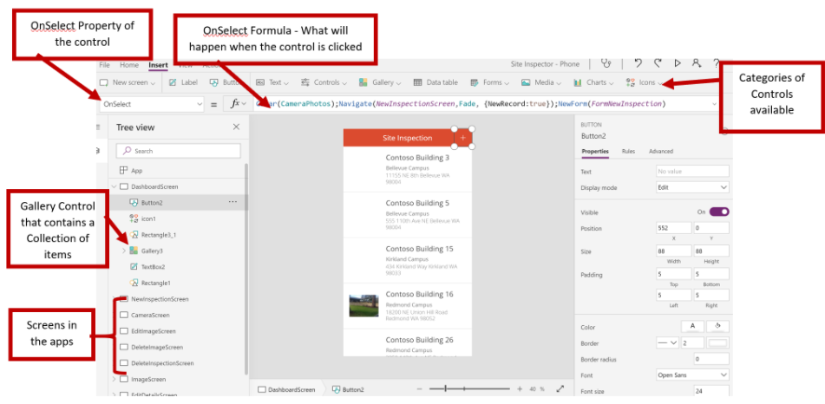
Power Apps Controls

Slide 34
App Samples and Templates
Power Apps Template
PowerApps come with multiple templates that you can use as a starting point. This will allow you to explore the different components and formulas in an existing, functional app. It will give you a feel for what you can do and how you can leverage PowerApps. You can customize the templates further or use them as is.
What are PowerApps templates?
App templates in PowerApps are a great way to jump start the creation of an app that can be deployed in your tenant. Those templates create a polished, finished app, and in many cases, it creates an Excel file so that the app can be used right away – and in most scenarios the app … Continue reading “Converting the Shoutouts template to SQL Server”.

Slide 35
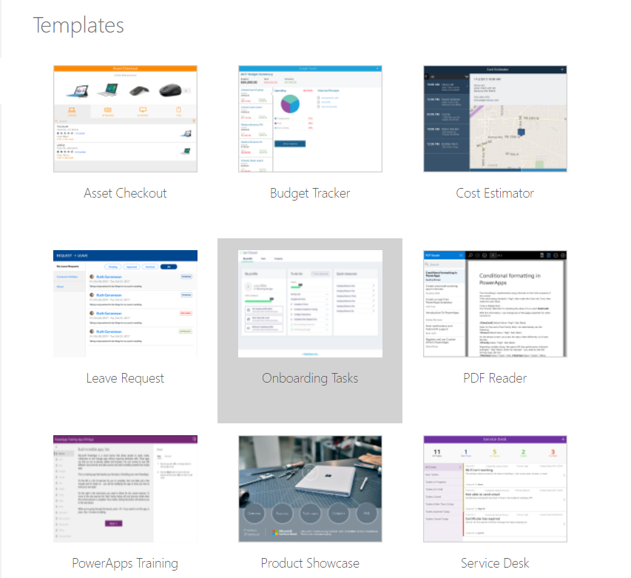
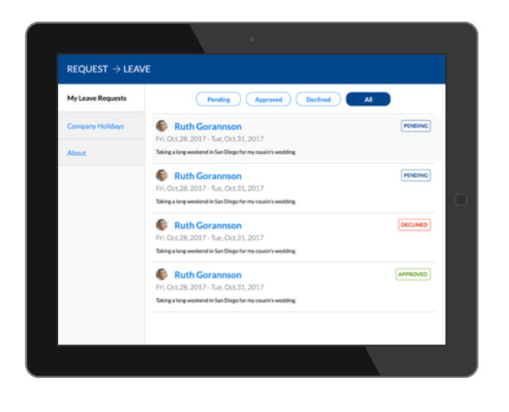
Power Apps Templates

Slide 36
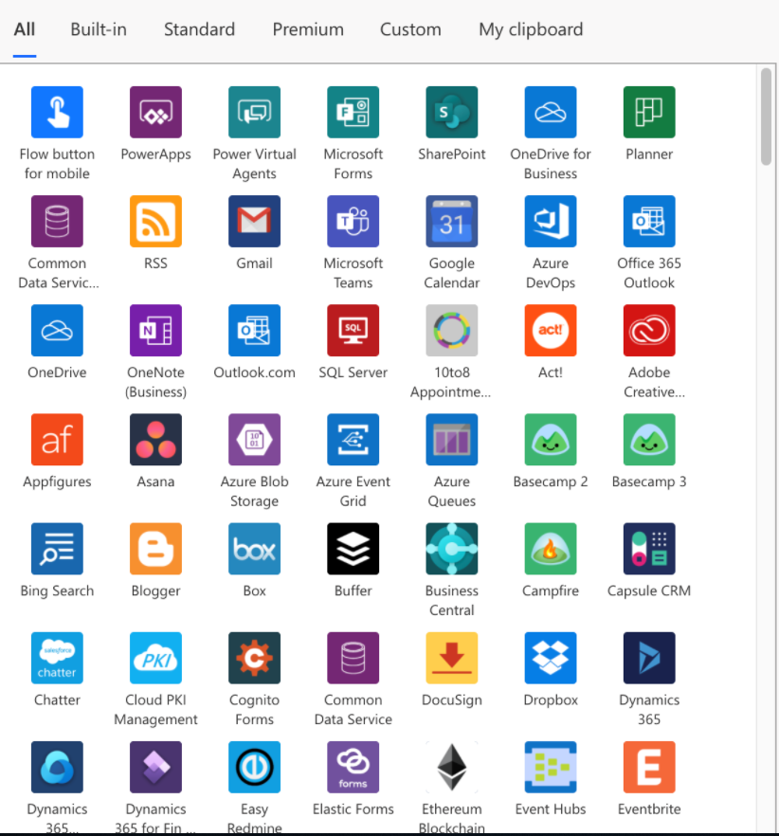
Power Apps Connections

Slide 37
Digitizing Business Scenarios with PowerApps
It's nothing but developing the Power Apps only for Business Purpose.
For Example
We can consider Leave Request will be mainly for Digitizing Business.

Slide 38
Creating an App from SharePoint data
Live Demo

Slide 39
Customizing Galleries
Galleries are not but it's the DataTable.
Live Demo

Slide 40
Working with Forms
Live Demo

Slide 41
Formulas and Error Management
The formulas used in PowerApps are based on an excel-like inspired language also known as declarative logic. The app is constantly recalculating values based on the current input or state of the controls on the form. For example, in excel if you want to calculate the total value of a row, you will add a formula to a cell that will add up all the cells in that rows value. PowerApps works the same way. However, instead of calculating values based on other cells, it calculates values based on other controls (other text boxes, dropdown menus, galleries, etc).

Slide 42
Formulas
Please find the document to refer the formulas,
Functions, signals, and enumerations - Power Apps | Microsoft Docs

Slide 43
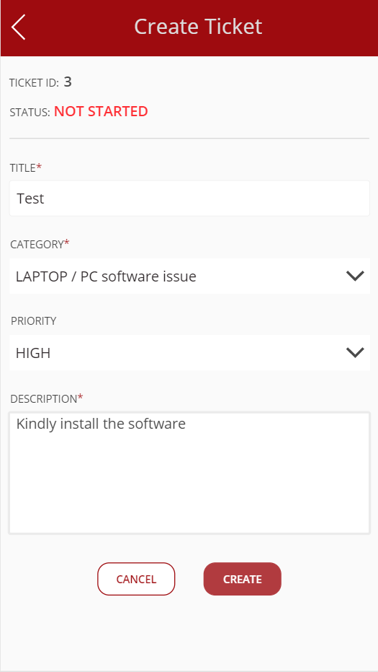
Creating apps from templates
We can create the Apps using the Templates as shown in the figure...

Slide 44
POWER APPS LIMITATIONS
JavaScript integration is not possible in PowerApps forms.
With PowerApps, you can retrieve a max of 500 items by default, but extendable up to 2000 (performance reduces)
Only one developer can work at a time if operating on the Canvas Application.
If SharePoint runs in the back end, attachment control will work fine. But if custom SQL runs in the backend, then attachment control will be disabled.
PowerApps cannot be shared with external users of your organization. It is designed to be used internally for your business purposes.

Slide 45
Thank You

